Slide 1
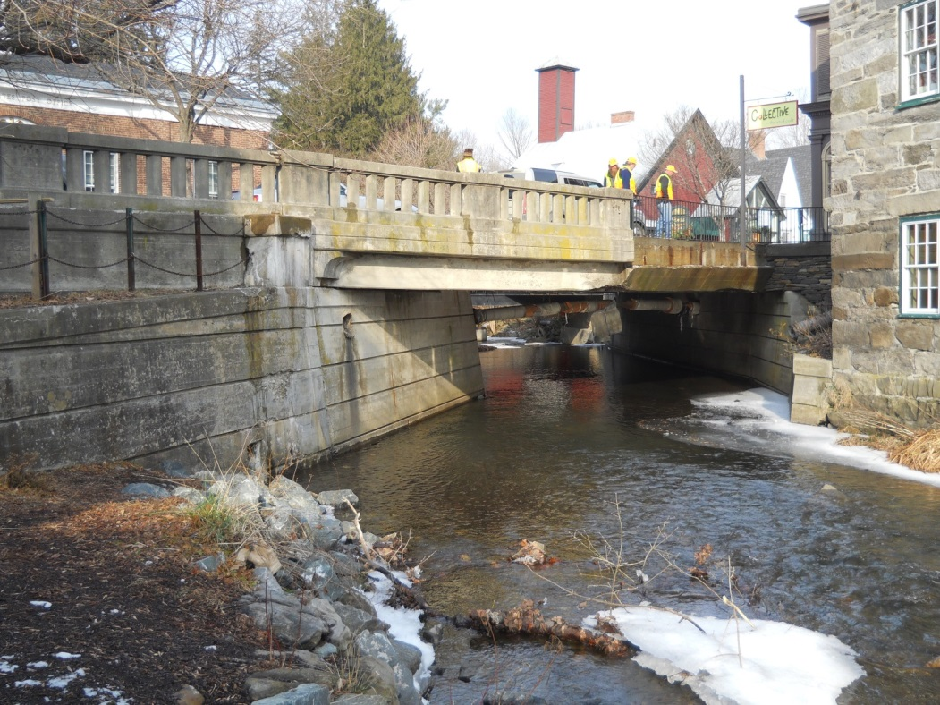

Woodstock Village BF 020-2(43)
Bridge Railing Alternatives Meeting
US Route 4 – Bridge #51 over Kedron Brook
December 13, 2016

Slide 2
Introductions
Rob Young, P.E.
VTrans Design Project Manager
Bill Lammer
VTrans Project Engineer
Kyle Obenauer
VTrans Historic Preservation Specialist

Slide 3
Purpose of Meeting
Project Schedule update
Provide an overview of Section 106 and 4(f) requirements
Provide an overview of bridge railing test levels
Discuss alternatives for new bridge railing
Provide an opportunity to ask questions and voice concerns

Slide 4
Project Schedule – Key dates
Final Plans/ Presentation - April 2017
Project Advertised - August 2017
Emergency Services
  PreClosure Meeting - March 2018
Bridge closure (21days) - April 2018
Bridge opening - May 2018
Project Complete - June 2018

Slide 5
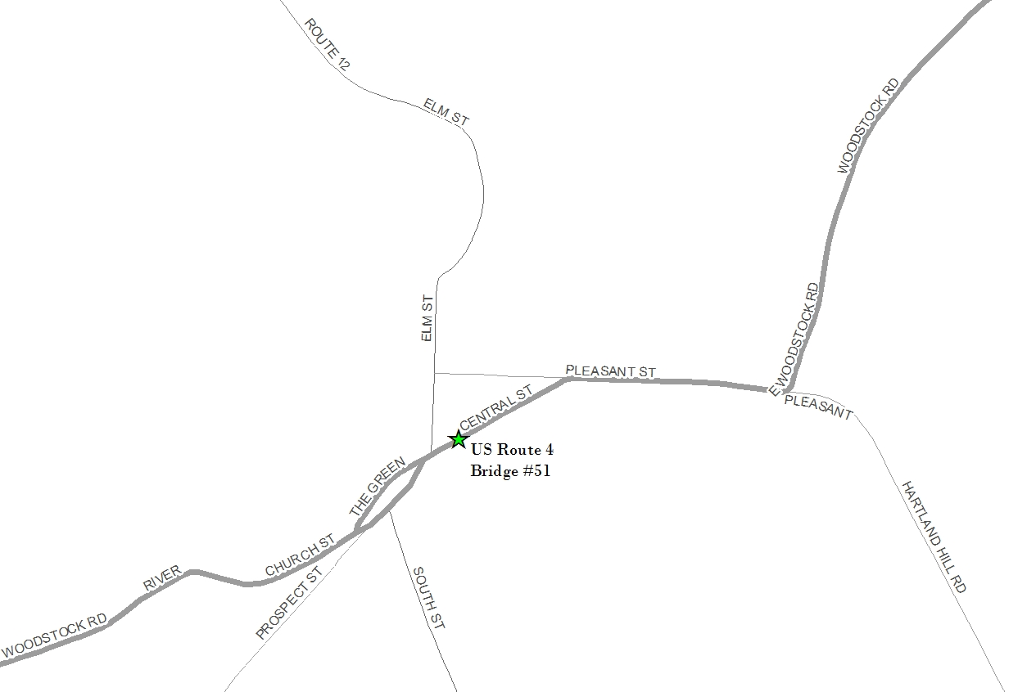

Location Map

Slide 6
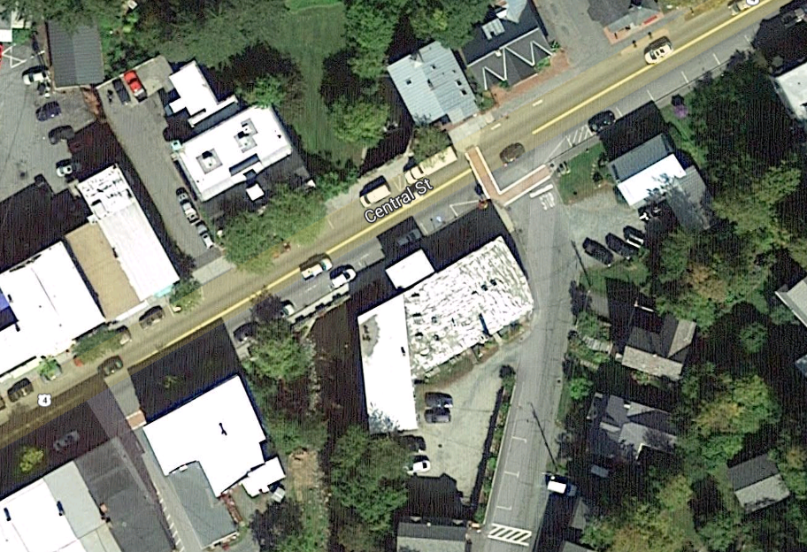
Project Location

Slide 7
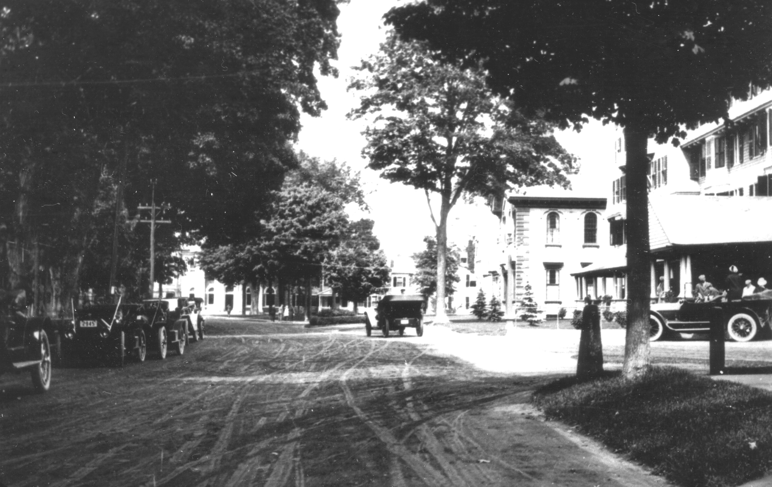
Section 106 of the National Historic Preservation Act
&
Section 4(f) of the Department of Transportation Act
Kyle Obenauer, VTrans Historic Preservation Specialist
(Woodstock Village, 1914)

Slide 8
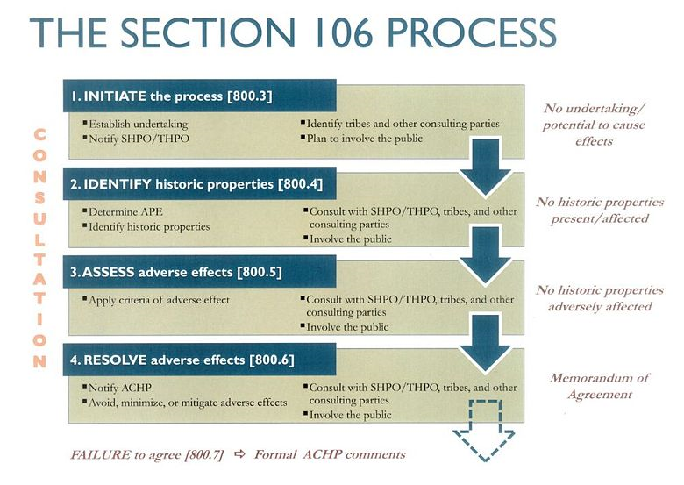
Section 106 Review
Section 106 of the National Historic Preservation Act (1966)
Requires that federal agencies having direct or indirect jurisdiction over a federally-funded undertaking take into account “the effect of the undertaking on any district, site, building, structure, or object that is included or eligible for inclusion in the National Register.”

Slide 9
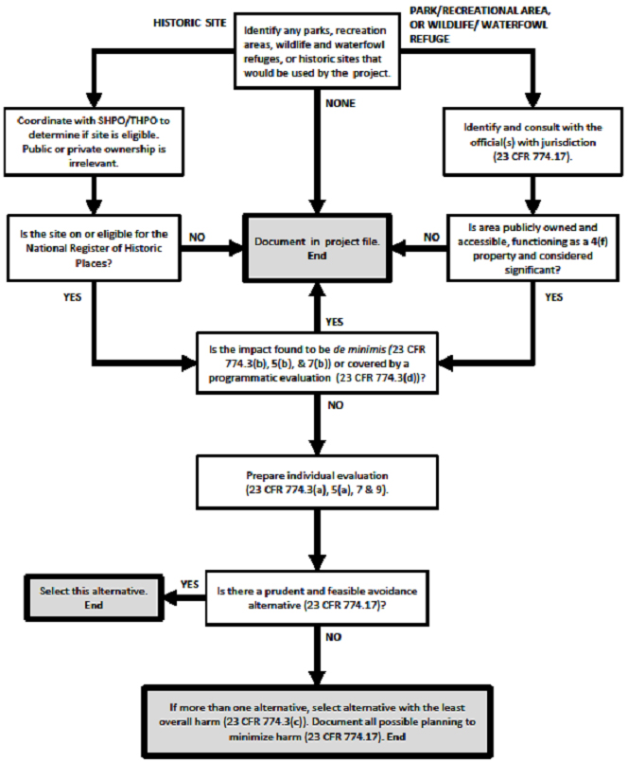
Section 4(f) Review
Section 4(f) of the Department of Transportation Act (1966)
Section 4(f) applies to projects that receive funding from or require approval by an agency of the U.S. Department of Transportation;
Section 4(f) refers to the original section within the U.S. Department of Transportation Act of 1966 which established the requirement for consideration of park and recreational lands, wildlife and waterfowl refuges, and historic sites in transportation project development.

Slide 10
Section 4(f) Review
Section 4(f) of the Department of Transportation Act (1966)
Use of a Section 4(f) property occurs: (1) when land is permanently incorporated into a transportation facility; or (2) when there is a temporary occupancy of land that is adverse in terms of the statute's preservation purpose; or (3) when there is a constructive use (a project's proximity impacts are so severe that the protected activities, features, or attributes of a property are substantially impaired).

Slide 11
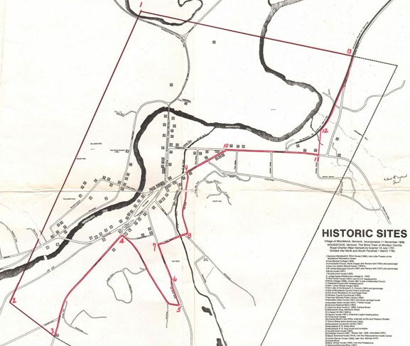
Woodstock Village Historic District

Slide 12
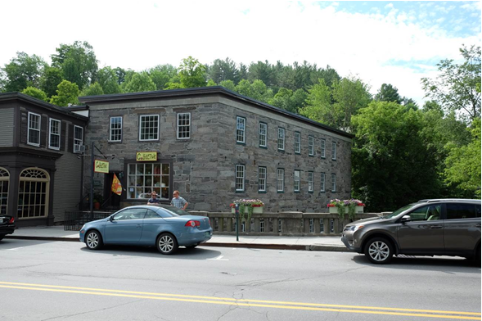
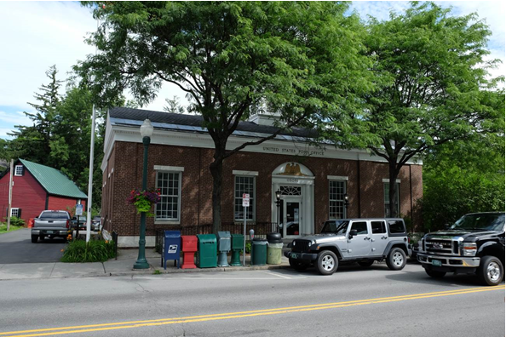
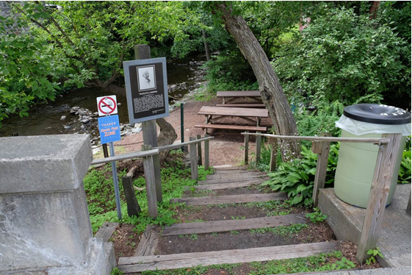
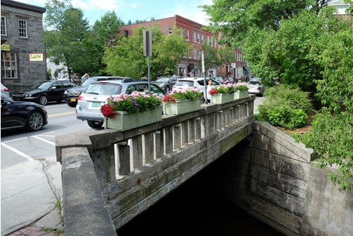
Figure 1. Former linseed oil building (c. 1840s) adjacent to Bridge No. 51 at southeastern corner. Contributing resource #23 to the Woodstock Village Historic District (top left).
Figure 2. PWA-funded Post Office at northwestern corner of Bridge No. 51, c. 1937. NRHP-eligible (top right).
Figure 3. Teagle’s Landing, a public park at the southwestern corner of Bridge No. 51. This park is a Section 4(f) resource.
Figure 4. Western railing of Bridge No. 51. Constructed in 1935, this structure is NRHP-eligible (bottom right).

Slide 13
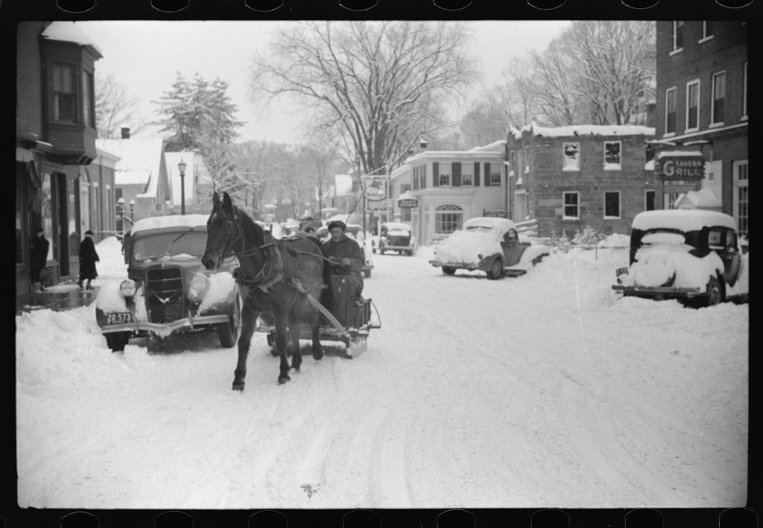
Questions?
Central Street looking at Bridge No. 51, March 1939 by Marion Post Wolcott.
Image courtesy of Library of Congress.

Slide 14
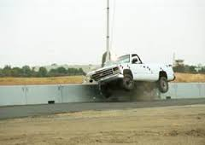
Bridge Railing Testing
Since the late 1980s the FHWA requires all bridge railings used on the National Highway System (NHS) to meet full-scale crash criteria.
The test criteria are documented in the AASHTO Manual for Assessing Safety Hardware (MASH), which is a 2009 update to NCHRP Report 350: Recommended Procedures for the Safety Performance Evaluation of Highway Features.
Notes:
- The test criteria are documented in the AASHTO Manual for Assessing Safety Hardware (MASH) (2009) which is an update of NCHRP Report 350: Recommended Procedures for the Safety Performance Evaluation of Highway Features.

Slide 15
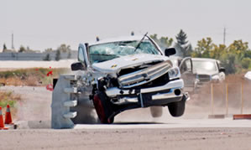
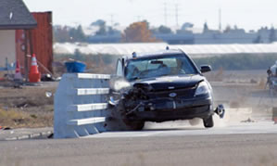
Bridge Railing Test Level
Six Test Levels (TL-1 through TL-6)
TL-1 through TL-3 are based on impact speed of passenger cars and pickup trucks, (31 mph for Test Level 1, 44 mph for Test Level 2, and 62 mph for Test Level 3.)
TL-4 through TL–6 contain additional tests for bridge railings designed to contain and redirect heavy vehicles such as buses and larger trucks.

Slide 16
NCHRP 350 Dynamic Testing
Three dynamic performance evaluation factors:
Structural Adequacy
  Test rail should contain and redirect the vehicle; the vehicle should not penetrate, underride, or override the installation; controlled lateral deflection of the rail is acceptable
Occupant Risk
  Parts of the test rail should not penetrate or show potential for penetrating the occupant compartment, or present an undue hazard to other traffic, pedestrians, or personnel in a work zone. Deformation of, or intrusions into, the occupant compartment that could cause serious injuries should not be permitted.
  The vehicle should remain upright during and after collision.
  Limit occupant impact velocity and ride-down to an acceptable range.
Post-impact Vehicular Response
After collision it is preferable that the vehicle’s trajectory not intrude into adjacent traffic lanes. The exit angle from the test article preferably should be less that 60 percent of the test impact angle, measured at time of vehicle loss of contact with test device

Slide 17
Bridge 51 Test Level Requirements
All new or replacement railing on NHS bridges must meet Test Level 3 crash-test criteria as a minimum.
Test Level 2 would be required at this location if not on NHS.
    Design speed less than 50 mph (25 mph on Central Street)(from Structures Design Man.)
    Relatively low traffic volume (ADT.adj = 7,420 < 48,000 vpd)
    Insignificant roadway grade (<1.0%)
    Straight alignment (no curvature)
    Low bridge deck height (<20 ft.) above shallow (<10 ft.) water
    Additionally: low accident history, on street parking, sidewalks on both sides.
A design exception will be submitted to FHWA if a TL-2 rail is chosen

Slide 18
Woodstock Village
BF 020-2(43)
Railing Options

Slide 19
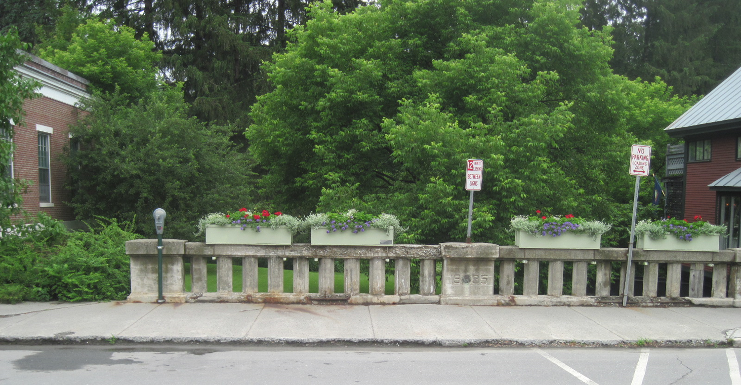
Existing Bridge Rail

Slide 20
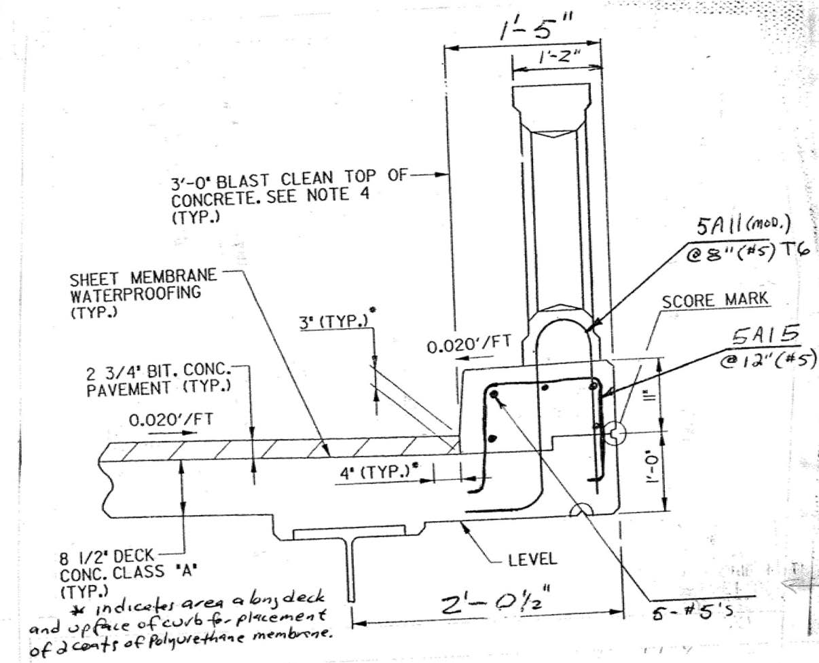
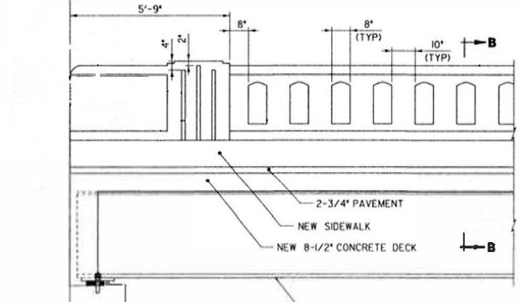
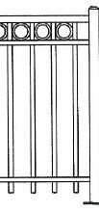
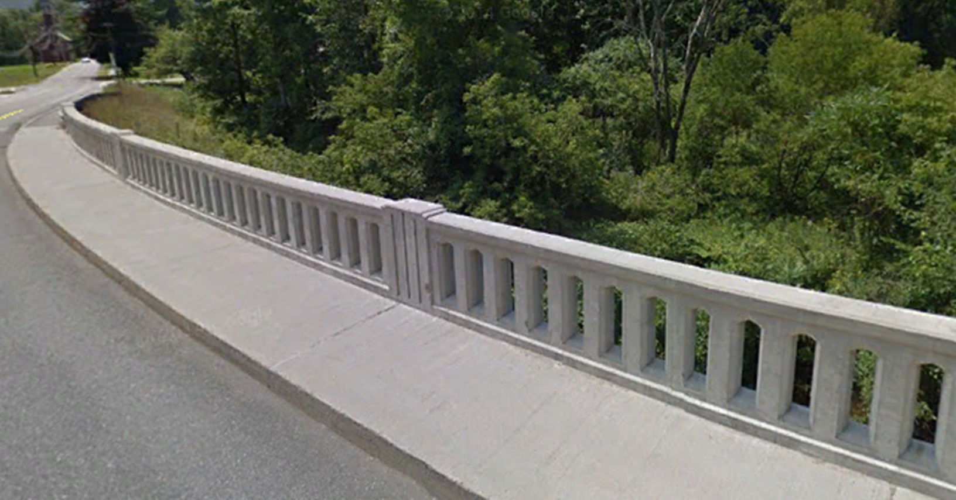
C411 Bridge Rail–Texas Classic (TL2)
Bridge Railing Elevation
Example Pedestrian Railing at Northwest and Southeast corner.

Slide 21
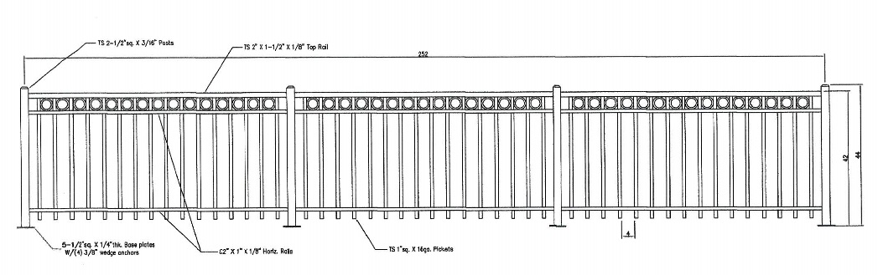
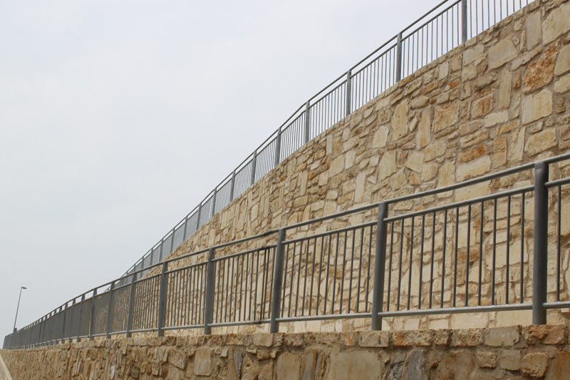
Example Pedestrian Rail

Slide 22
Evaluation of Concrete Rail Cracking

Slide 23
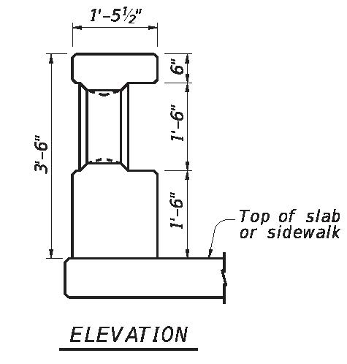
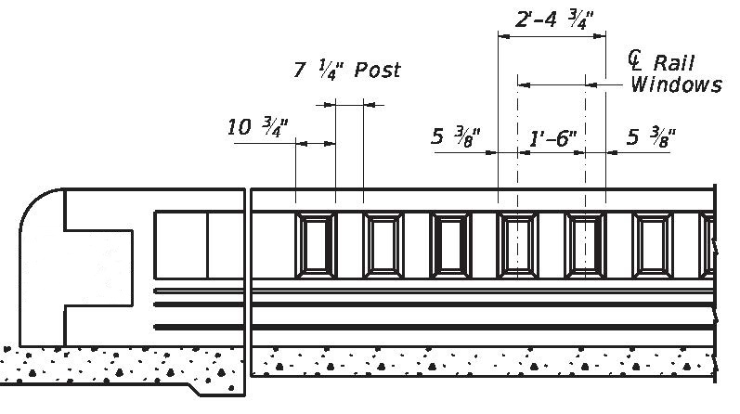
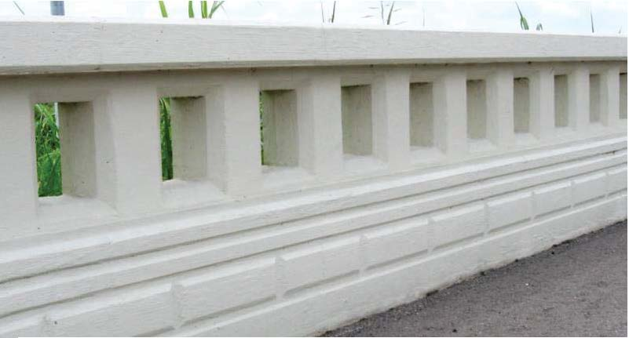
C412 Bridge Rail (TL-4)
Bridge Railing Elevation

Slide 24
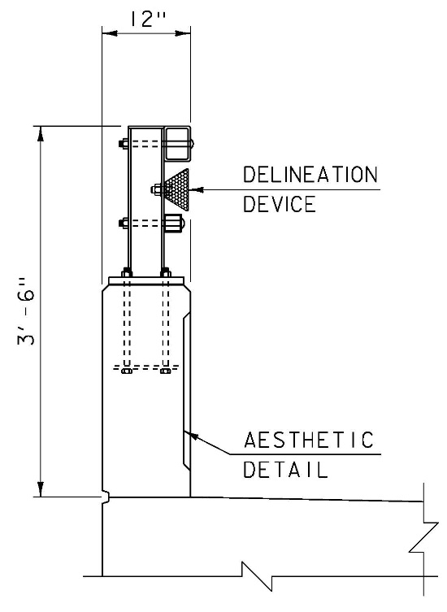
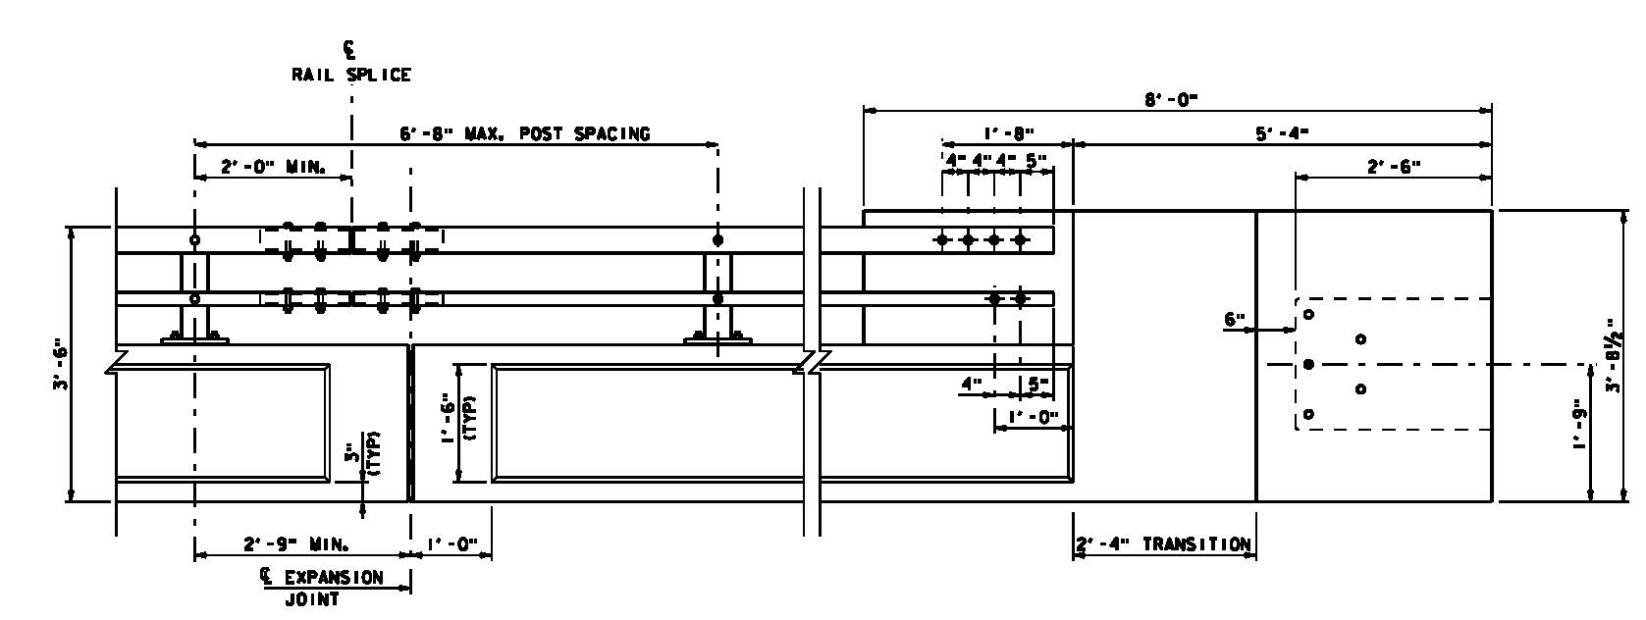
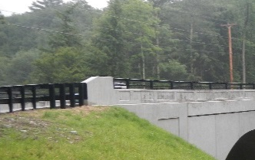
S-352 Combination Rail (TL-4)
Bridge Railing Elevation

Slide 25
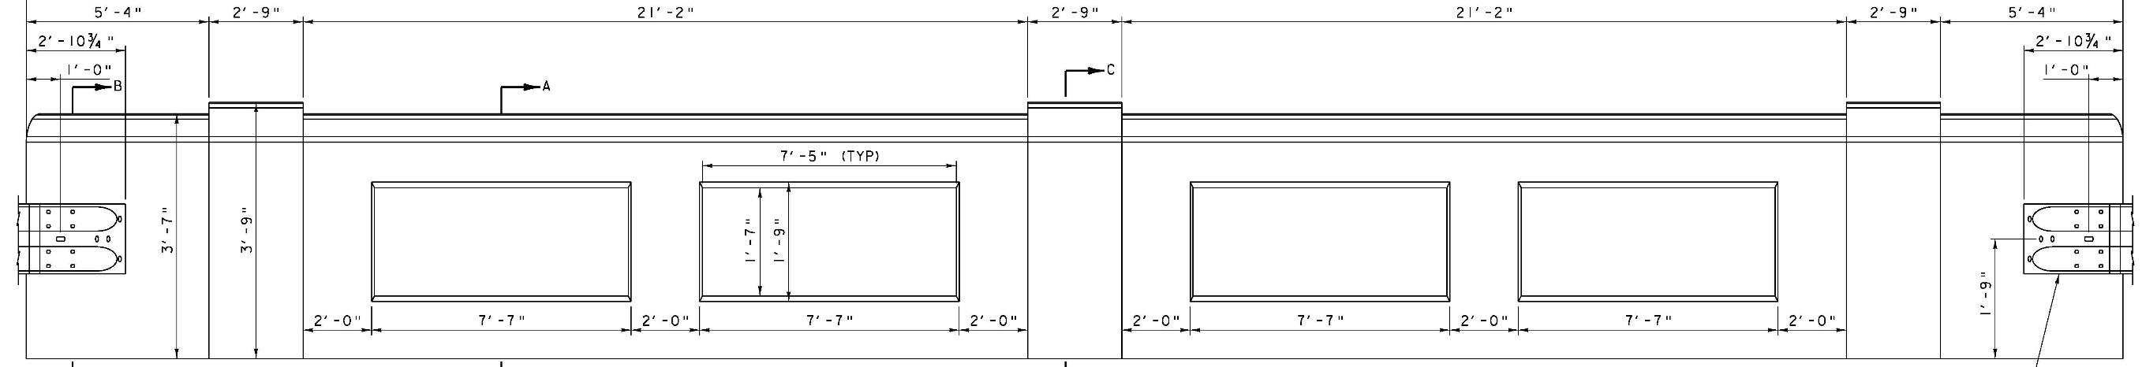
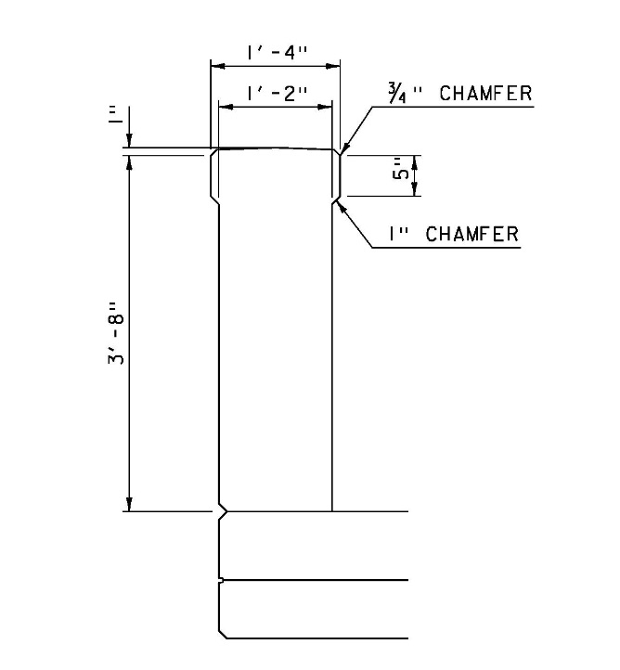
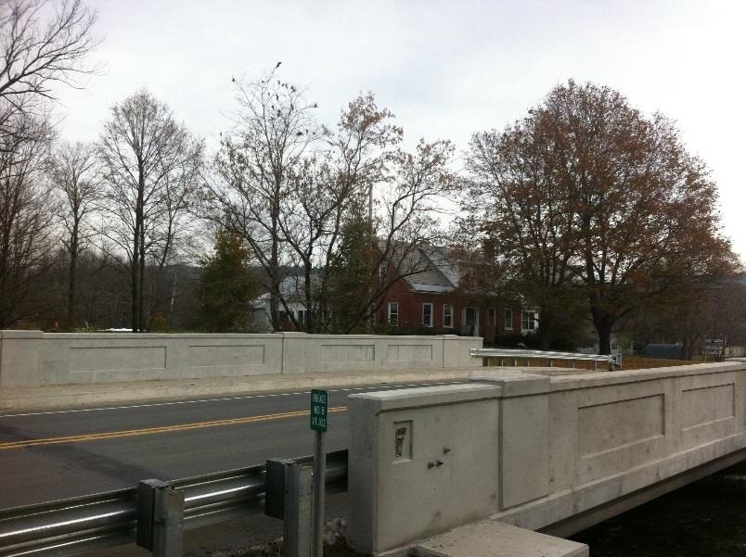
Concrete Bridge Railing – recessed panels(TL-2)
Bridge Railing Elevation

Slide 26
FOLLOW UP:
Vtrans requests a letter indicating choice of bridge rail
  If a TL-2 is chosen then a design exception will be submitted to FHWA
  Letter should indicate a TL-4 second choice

Slide 27
Questions

